Slide 1
CSE1201: Object Oriented Programming-I (C++)
Lecture 13

Slide 2
Outline
Copy Constructor

Slide 3
Copy Constructor
A copy constructor is a member function which initializes an object using another object of the same class.
A copy constructor has the following general function prototype:
ClassName (const ClassName &old_obj);

Slide 4
Copy Constructor
#include<iostream>
using namespace std;
class Point
{
private:
int x, y;
public:
Point(int x1, int y1) { x = x1; y = y1; }
// Copy constructor
Point(const Point &p2) {x = p2.x; y = p2.y; }
int getX() { return x; }
int getY() { return y; }
};
int main()
{
Point p1(10, 15); // Normal constructor is called here
Point p2 = p1; // Copy constructor is called here
// Let us access values assigned by constructors
cout << "p1.x = " << p1.getX() << ", p1.y = " << p1.getY();
cout << "\np2.x = " << p2.getX() << ", p2.y = " << p2.getY();
return 0;
}
Output:
p1.x = 10, p1.y = 15
p2.x = 10, p2.y = 15

Slide 5
When is copy constructor called?
When an object of the class is returned by value.
When an object of the class is passed (to a function) by value as an argument.
When an object is constructed based on another object of the same class.
When the compiler generates a temporary object.

Slide 6
When is copy constructor called?
Object initialization can occur in three ways:
When an object is used to initialize another in a declaration statement
MyClass y;
MyClass x = y;
When an object is passed as a parameter to a function
MyClass y;
func1(y); // calls “void func1( MyClass obj )”
When a temporary object is created for use as a return value by a function
MyClass y = func2();
// gets the object returned from “MyClass func2()”

Slide 7
Why Copy Constructor is Needed?
By default when we assign an object to another object, or initialize a new object by an existing object, a bitwise (member wise) copy is performed.
The compiler created default copy constructor works fine in general.
This cause problems when the objects contain pointer/reference to dynamically allocated memory
Pointer in both objects will point to same memory address
When destructors are used to free that memory, It causes the same memory to be released multiple times.

Slide 8
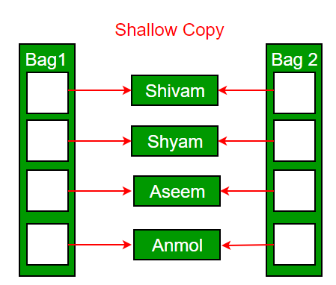
Default Copy Constructor
The default copy constructor can only produce the shallow copy.
A Shallow copy is defined as the process of creating the copy of an object by copying data of all the member variables as it is.

Slide 9
User-defined Copy Constructor
User defined Copy constructors can be used to solve this problem, while we perform object initialization with another object of the same class.
MyClass ob1;
MyClass ob2 = ob1; // uses copy constructor

Slide 10
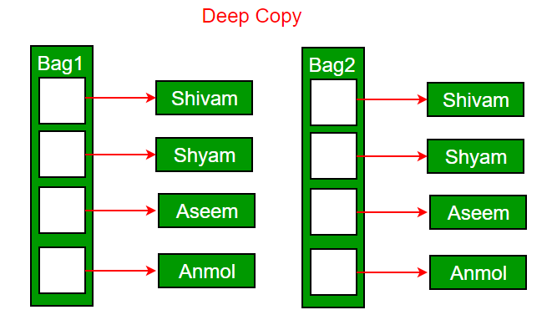
User-defined Copy Constructor
User-defined Copy constructors perform Deep copy of the object.
Deep copy dynamically allocates the memory for the copy and then copies the actual value, both the source and copy have distinct memory locations.
Both the source and copy are distinct and will not share the same memory location.

Slide 11
Copy Constructor Vs. Assignment Operator
Copy constructor is called when a new object is created from an existing object, as a copy of the existing object.
Assignment operator is called when an already initialized object is assigned a new value from another existing object.
Copy constructors do not affect assignment operations.
MyClass t1, t2;
MyClass t3 = t1; // ----> (copy)
t2 = t1; // -----> (assignement)

Slide 12
Reference
Chapter 14
[ C++ : The complete reference ]

Slide 13
Thank you

